Slide 1
Topologies
Richard Maiden - Altera Corporation
8th December 2015

Slide 2
Logical Connections
Similar to CPRI ‘Service Access Points’
A ‘Link’ is a physical connection
With 3 possible logical connections (Flow types)
  RoE Timing Packets
  RoE Control Packets
  RoE Data Packets
  Each is optional
  Each may or may not share the same flowID
It may have multiple hops
RoE differences,
  No distinction between REC/RE
  Each node may or may not be an end-point
  Flows are uni-directional (defined as UL/DL/Bi-directional)
  Flows may or may not be terminated (a transparent Ethernet switch)

Slide 3
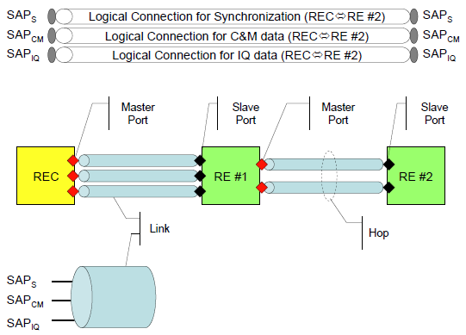
Logical Connections
RoE
CPRI

Slide 4



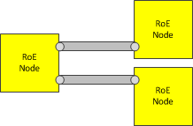
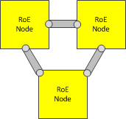
Topologies (as CPRI)
Point-to-point
Multiple point-to-point (star)
Chain
Tree
Ring

Slide 5
Motion
Accept logical connection definitions
Accept supported topologies

Slide 6

Thank-you

